Slide 1
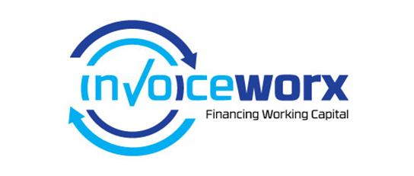
Invoice Worx Supply Chain Financing Platform

Slide 2
Problem Payments from debtors take too long (30,60,90 days). Poor credit status means SMMEs cannot raise working capital. SMMEs are unable to collect outstanding debts on time. Sending , tracking and storing of invoices is a is a problem for SMMEs.

Slide 3
Solution Invoice Worx is a platform that allow suppliers to auction their invoices at the best rate to multiply lenders. No credit Checks are done on the supplier. Suppliers are advanced 80%-90% of their invoice value within 72 hours. Through e-Invoicing the platform allows you to send, track and store all invoices electronically. Our system is built with an automated collection function allowing to directly debit the account of the customer that owes you.

Slide 4
Customers and their Benefits Our system has three type of users: Supplier - Improved cash flow, better management of debtors. Buyers- Claim enterprise development points by paying the supplier on time (within 15 days). Finance their Payables. Funders- Alternative funding mechanism, grow their debtor book and get attractive yields.

Slide 5

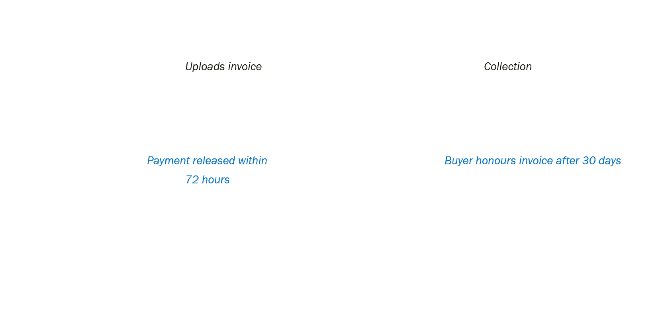
Business and Revenue Model
SUPPLIER
INVOICE WORX charges 2% of every invoice cleared through the platform Subscription from suppliers for e-Invoicing
BUYER
Send, Track and Store
Automated Collections System
FUNDERS

Slide 6
Markets
$1 Trillion
Emerging Markets
Globally
$800 085 mil
Sub-Sahara
$80 000 mil
Our targeted Market Share
The global supply chain finance gap according to the International Finance Corporation.

Slide 7
Mile Stones Reached
Invoice Worx has secured the first funder to participate on the platform. 30 October 2015
Piloting with our first Buyer. 1 March 2016

Slide 8

Thank You.
Contact
Siya Ntutela
012 657 1083
071 420 4340

